Slide 1
Better Decision Making for New York City Taxi Drivers
Kefu Zhu, Chunlei Zhou

Slide 2
Contents
Related Works
Problem Statement
Methodology
Experiments
Conclusions
Reference

Slide 3
Related Works
How the trend changes among different types of taxis across time and area?
What are the factors that influences the ride duration?
What is the average speed of a trip at a particular hour of the day?
Where are the hot pickup/dropoff areas in the New York City?
…
We would like to study on something new and discover new things that has been ignored.

Slide 4
Problem Statement
Data Source:
TLC (TLC Trip Record Data: https://www1.nyc.gov/site/tlc/about/tlc-trip-record-data.page )
Datasets used in the project:
2018 data for yellow taxi and green taxi in both March (winter season) and August (summer season)
Detailed Dictionary of attribute:
Numeric Attributes: Passenger_count, Trip_distance, duration, Total_amount, Tip_amount, …
Categorical Attributes: Payment_type, time(shift), RatecodeID…
For more details please visit https://www1.nyc.gov/assets/tlc/downloads/pdf/data_dictionary_trip_records_yellow.pdf

Slide 5
Problem Statement
Purpose:
1. Study how can a taxi driver make better decisions;
2. Explore the customer profile of taxi passengers within NYC.
Questions Answered in the project:
1. Where should the drivers go for pickups if they want higher tip earnings?
2. Will the effect of weather and time influence the income of taxi drivers?
3. What are the intrinsic properties of different customer groups for both yellow and green taxi?

Slide 6
Methodology
To explore the customer profile:
K-means
K-modes
DBSCAN
To investigate the impact of weather and time on drivers’ income:
Hypothesis testing

Slide 7
Experiments 1. Tip in Different Pick up locations
Examined two metrics: the tip amount and tip as a percentage of total fare.
LocationID: the ID of different areas within the New York City.
Results as following…

Slide 8
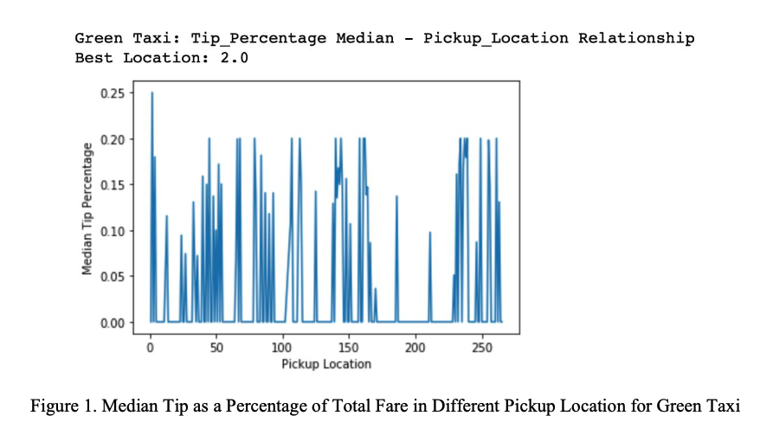
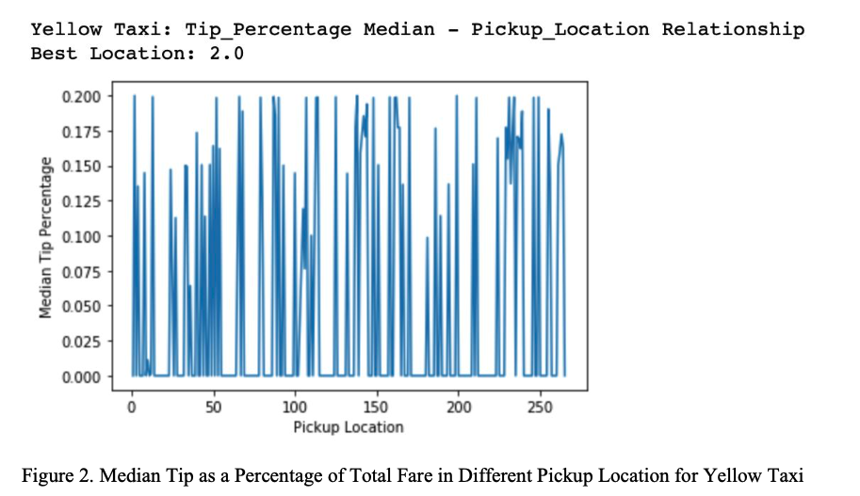
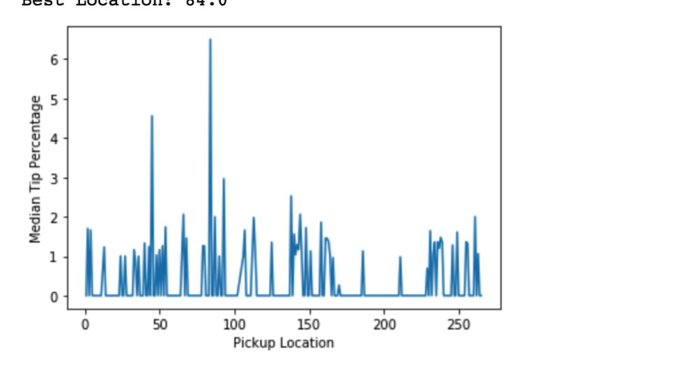
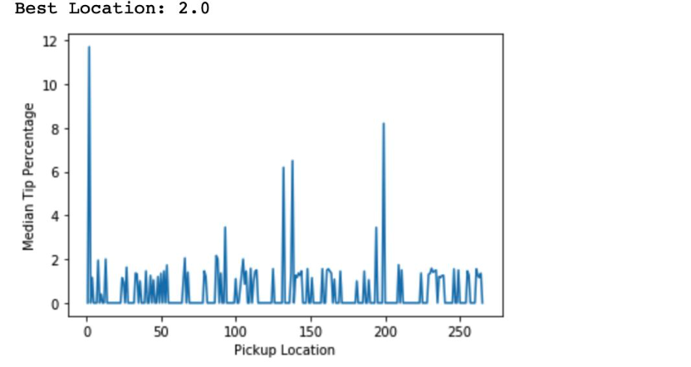

Slide 9
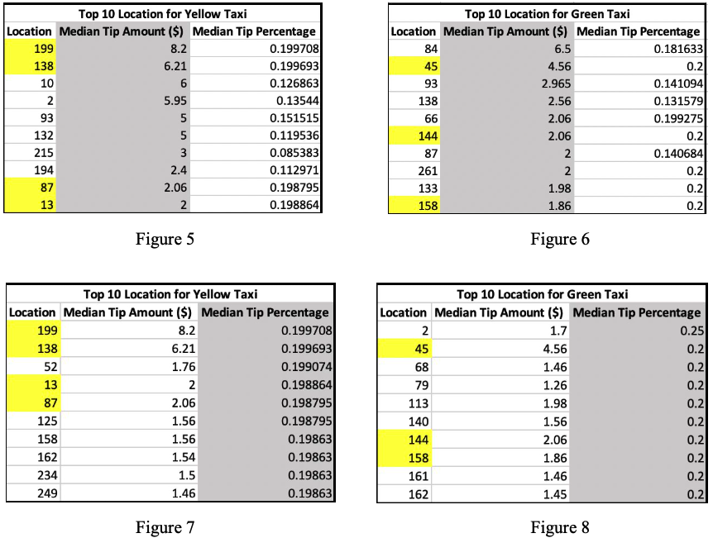
Experiments 1. Tip in Different Pick up locations
Among total of 257 regions, trips that pickup passengers in some regions tend to have higher tip amount as well as higher tip as a percentage of total fare.
Though the top 10 locations for high tip can vary, some regions remain in the list even when switching the evaluation metric (highlighted in yellow). Location 13, 87, 138 and 199 are in the top 10 list for yellow taxi drivers. Similarly, location 45, 144 and 158 for green taxi.

Slide 10
Experiments 2. Drivers Income in Extreme Weather
In 2018, NYC experienced 2 winter storms in March (03/06 - 03/08 and 03/20 - 03/22) and 2 severe thunderstorms in August (08/07 and 08/11). We proposed two metrics to measure the income of taxi driver, income per second ($/s) and total fare ($).
After removing extreme values, surprisingly, either the income of yellow taxi drivers or that of green taxi drivers are not affected by either winter storm or severe thunderstorm no matter which metric is used to evaluate.
Barely see any difference from the density plot, thus, we conclude that there is no point to proceed on doing the hypothesis testing.

Slide 11
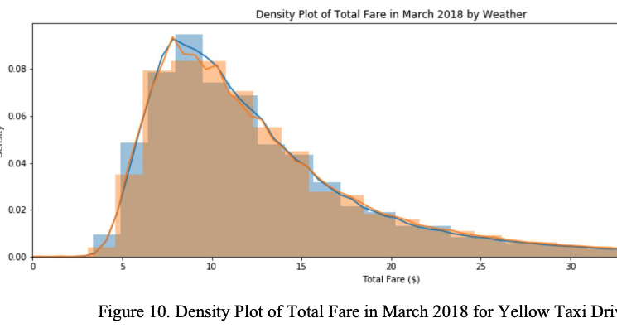
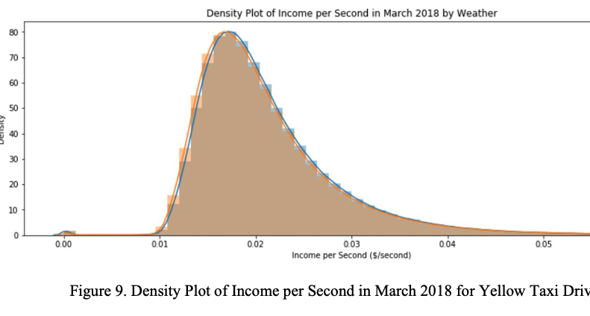
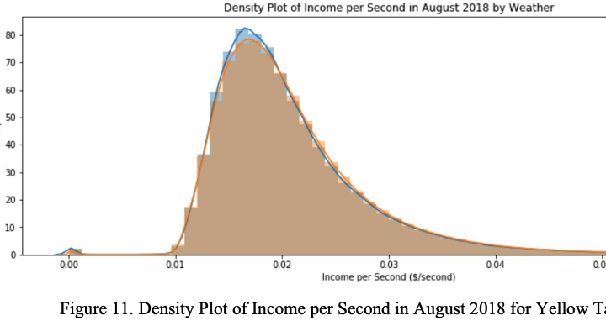
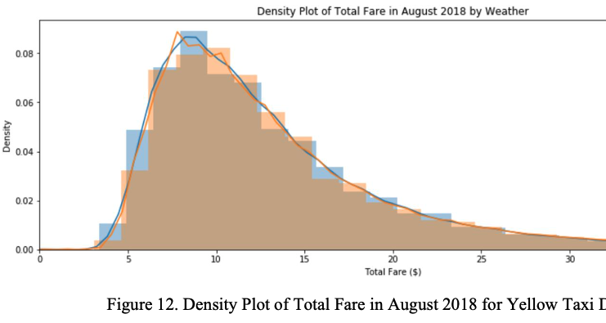

Slide 12

Experiments 3. Drivers Income in Different Times of a Day
The original pickup and dropoff time of each trip is recorded as timestamp. We aggregated the trips into five different time window for better analysis.
Five different time windows:
morning (6am - 11am);
noon (11am - 2pm);
afternoon (2pm - 6pm);
night (6pm - 12am);
late-night (12am - 6am).

Slide 13
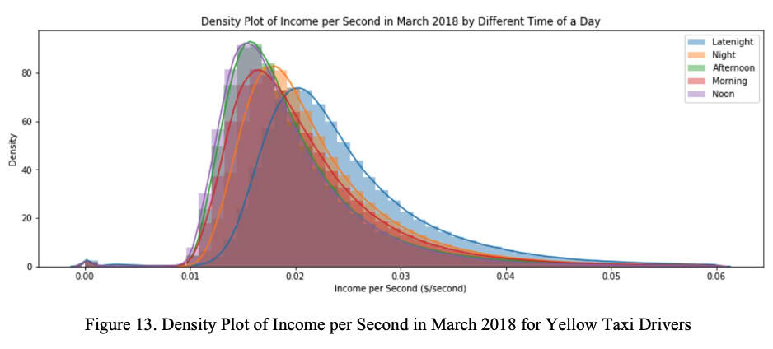
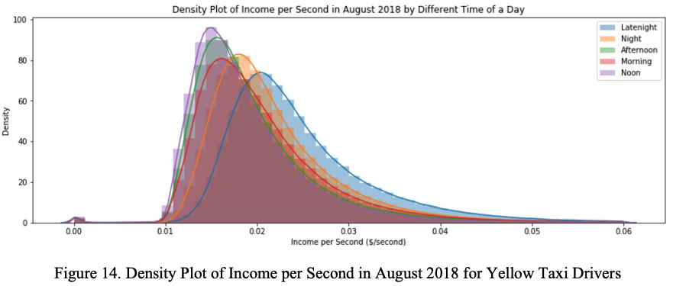
Experiments 3. Drivers Income in Different Times of a Day
During the night (6pm - 12am) and late-night (12am - 6am), taxi drivers earn higher income per second.
Trips in the morning (6am - 11am) also tend to have higher return compared to trips in the noon (11am - 2pm) and afternoon (2pm - 6pm).

Slide 14
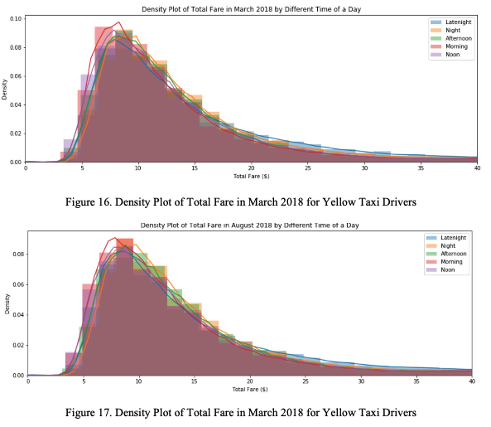
Experiments 3. Drivers Income in Different Times of a Day
However, if we evaluate the trips using the other metric, total fare amount, it is hard to conclude that there is any significant difference among the total fare of trips in different time of a day.

Slide 15
Experiments 3. Drivers Income in Different Times of a Day
Since the trips during night and late-night seem to yield higher return for yellow taxi drivers. We conducted hypothesis testing using pairwise t-test to compare the return from trips during the day (6am-8pm) and night (8pm-6am).
The p-value is close to zero, which means the return from trips during the night is significantly higher than the return from trips during the day.

Slide 16
Experiments 4. Customer Profile 4.1 K-means/K-modes
Trips that have more passengers give lower tip, and tip amount is not necessarily positively correlated with total fare amount.
Box plot for each cluster related to different attributes are given in next slide…

Slide 17
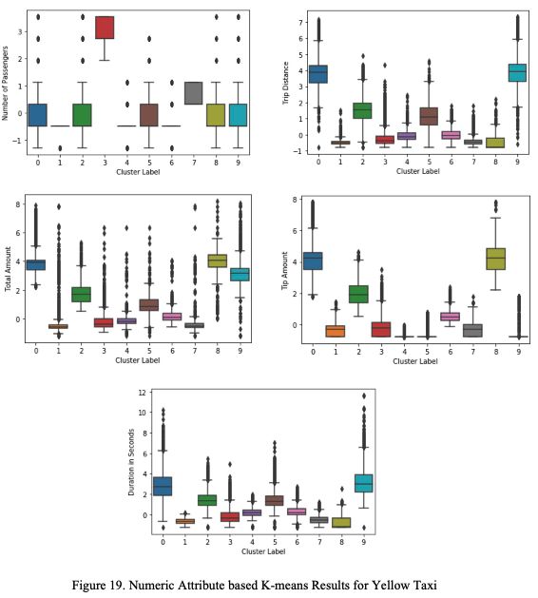
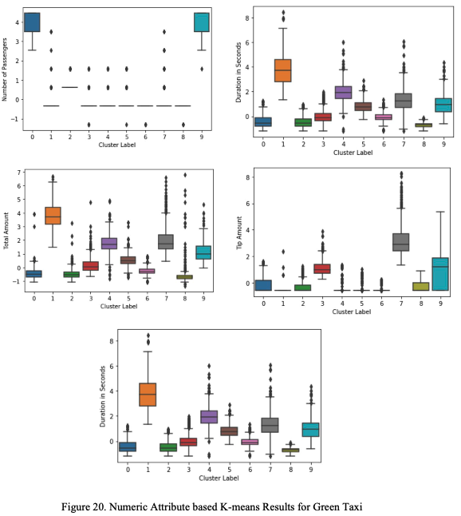

Slide 18
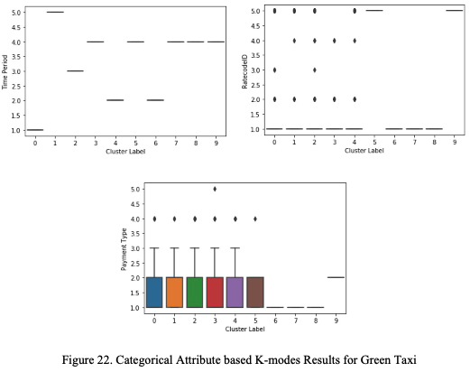
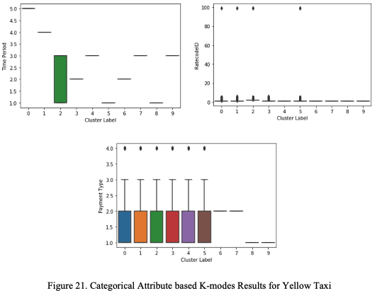

Slide 19
Experiments 4. Customer Profile 4.2 DBSCAN
DBSCAN uses number of passengers as main indicator for different clusters. For the rest of numeric attributes, only cluster 6 and cluster 8 behave differently for yellow taxi, which tend to have higher values in the selected numeric attributes compared to other clusters.
For green taxi, the results basically provide no valuable information. Furthermore, when using categorical attributes as input, DBSCAN is not able to separate the data and outputs only one giant cluster.
Box plot for each cluster related to different attributes are given in next slide…

Slide 20
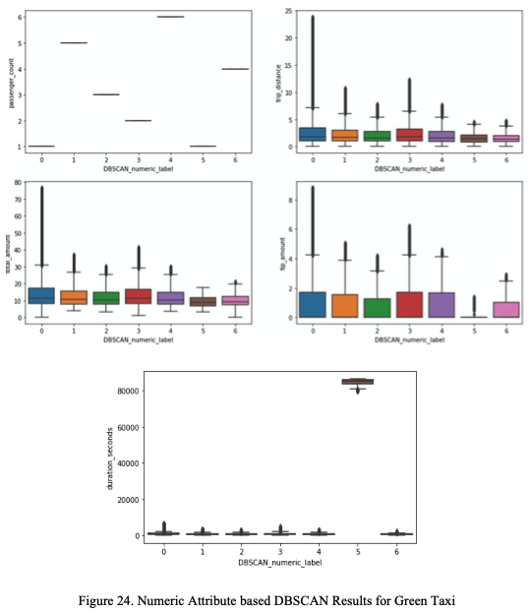
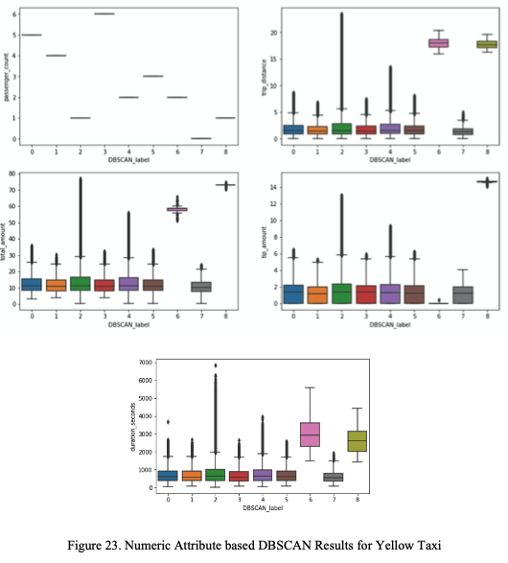

Slide 21
Conclusions
Some regions in the New York city provide trips for the taxi driver that potentially have higher tips.
As a NYC taxi driver, working on shift during the night (6pm - 12am) and late-night (12am - 6am) is likely to yield more income.
There is no apparent difference between normal trips and trips during extreme weather from a perspective of driver’s earnings.
Passenger groups with different size have different behaviors in trip distance (in miles), total fare amount, tip amount and duration of the trip (in seconds), but they do not necessarily differ in the going on a specific route or using distinctive payment types.

Slide 22
Reference
1. Todd W. Schneider. November 2015. Analyzing 1.1 Billion NYC Taxi and Uber Trips, with a Vengeance. Retrieved from: https://toddwschneider.com/posts/analyzing-1-1-billion-nyc-taxi-and-uber-trips-with-a-vengeanc e/
2. Kaggle. 2017. New York City Taxi Trip Duration.
3. Shashank Badre. December 03, 2017. Exploratory data analysis on Green Taxi. Retrieved from:​http://rstudio-pubs-static.s3.amazonaws.com/326454_0e4d6355b75a4578bebac6cd99cc319 f.html
4. Chih-Ling Hsu. May 14, 2018. Analyze the NYC Taxi Data. Retrieved from:
https://chih-ling-hsu.github.io/2018/05/14/NYC#q1-which-regions-have-most-pickups-and-drop- offs 5. Willy Sebastian. June 2, 2018. New York Taxi Trip Analysis. Retrieved from: https://rpubs.com/willyarrows/NYCTaxiTripsAnalysis
6. Xuefeng Peng, Yiming Pan, and Jiebo Luo, "Predicting High Taxi Demand Regions Using Social Media Check-ins," Special Session on Intelligent Data Mining, IEEE Big Data Conference, Boston, MA, December 2017.​

Slide 23

Thank you for your time!

